Slide 1

Top 20 mistakes you will make in your 1st Drupal project
Iztok Smolič, 8. 12. zagreb

Slide 2

Who is this guy?
@iztok www.twitter.com/iztok
Drupal site builder, themer and developer
Passion about UX and design
Drupal consultant www.iztoksmolic.com
Manager at Agile Drop www.agiledrop.com
Drupal Slovenia Association organizing meetups in Ljubljana

Slide 3
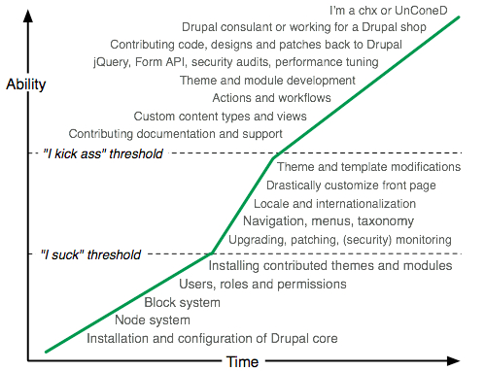
The common wrong dispositions
I know MySQL/PHP, I know Drupal
There is a module for anything like in Joomla/Wordpress
Drupal has a long and steep learning curve
After 5 years I am here.
Notes:
I know MySQL/PHP, I know Drupal
I confess that I still suck at PHP, but I can still build an advance Drupal project (even coding with Drupal “API”)
There is a module for anything like in Joomla/Wordpress
Drupal modules rarely bring full features like Image gallery or Slideshow, but together with Field UI, Views, Views Slideshow and Colorbox you can build a Slideshow video gallery.
Drupal has a long and steep learning curve
5 years ago I was designing posters and now I help senior PHP developers understand Drupal.

Slide 4
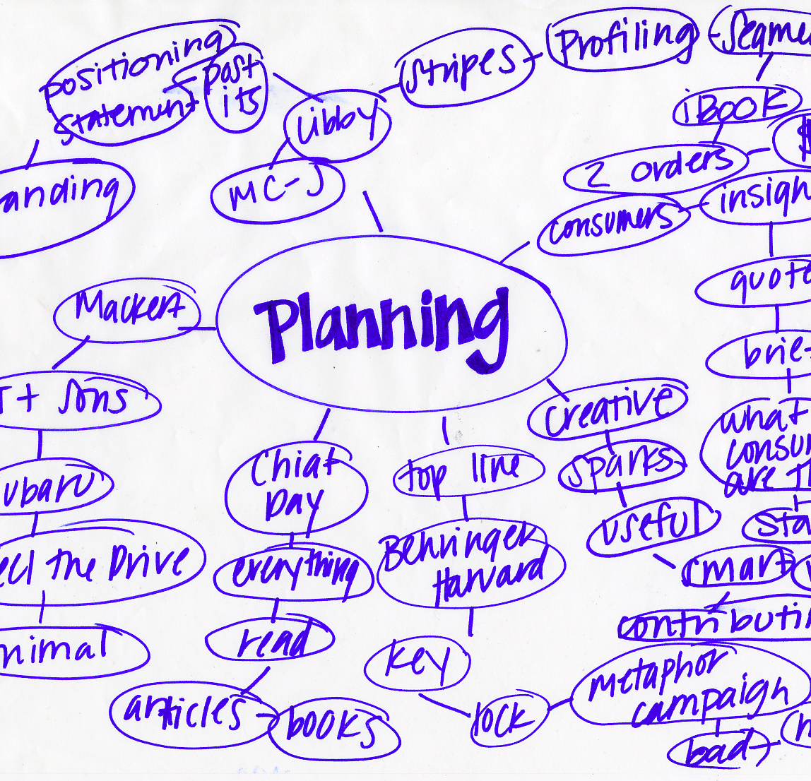
Planing
Fail to plan, plan to fail

Slide 5
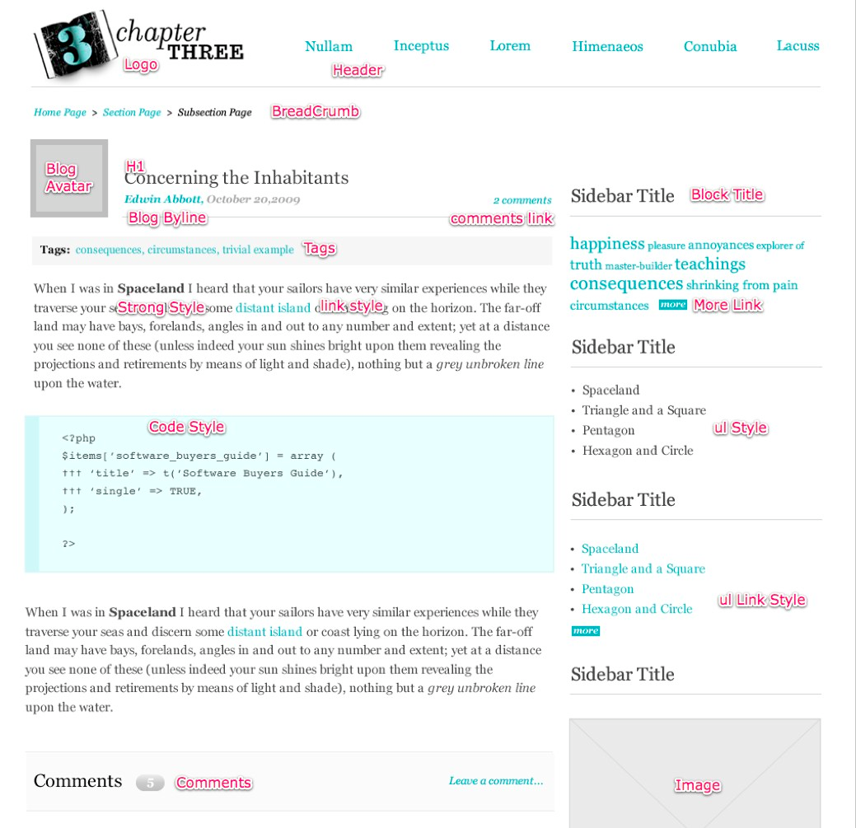
1. Not knowing the furniture
Designer must be aware of the common elements.
Check this blog post from Chapter Three

Slide 6
2. Over-designing forms
HTML markup is predefined for form
altering markup requires development skills
Solution
Style forms: http://drupal.org/project/uniform
Group fields: http://drupal.org/project/field_group
Add element (and wrappers) with hook_form_alter

Slide 7
3. Bad content architecture decisions
using too much content types
(e.g. is Article really so different from Public release? Maybe we can use category to separate them)
not using node types
(e.g. instead of listing staff as a table in the Page body, maybe build the page with Views and content type Staff member)
No real formula, just practice and experiences.

Slide 8

Site building
Installation and configuration

Slide 9
4. Wrong folder structure
If using single site installation (one Drupal core, one website) put:
themes in /sites/default/themes
modules from drupal.org in /sites/default/modules/contrib
custom modules in /sites/default/modules/custom
Do not put themes and modules in the folder on the root level.
Never. You can use all folder instead of default – your call.
More about this: http://drupal.org/node/120641

Slide 10
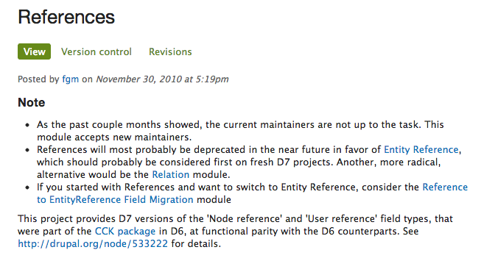
5. Choosing unsupported module
Check the usage/download counter, last update, open issues counter, all that can give a idea about the module status.
Read the description, in many cases authors let the people know that module will be deprecated in favor of some other more comprehensive module.

Slide 11
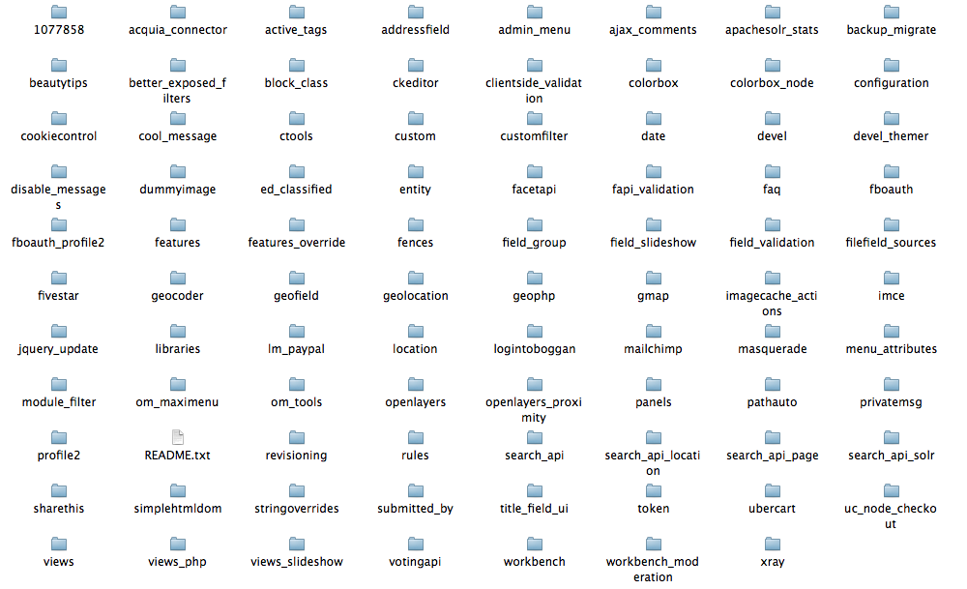
6. Orphaned modules
Clean your environment, or even better, test modules on other installations!
Leaving old, unused modules can confuse you latter on, not to mention other developers.

Slide 12
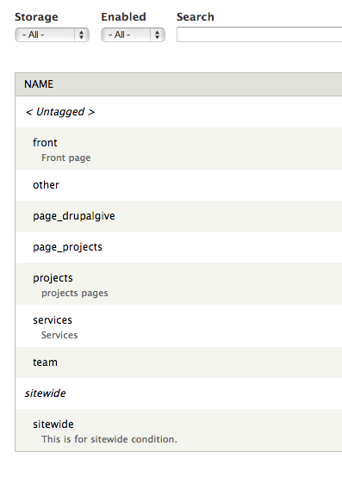
7. Using default blocks SYSTEM
Use default blocks system only if project is very very simple.
A couple of attempts were made to improve block system, I bet on the following two:
Context, which is block system on steroids
Panels, introduces new block-like concept

Slide 13
8. Putting content/code in blocks
Default blocks allow user generated content, but you can't set permissions for editing different blocks
Bean, you can add fields to different blocks types, which have separate permissions (like content types do)
Boxes, blocks with a unique machine names

Slide 14

Theming
Implementing your design into Drupal

Slide 15
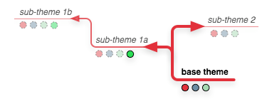
9. Hacking core/contrib theme
if you decided to use a theme from core or from drupal.org, there is no need to go and edit its code. Make a sub-theme
more about creating sub-theme: http://drupal.org/node/225125

Slide 16
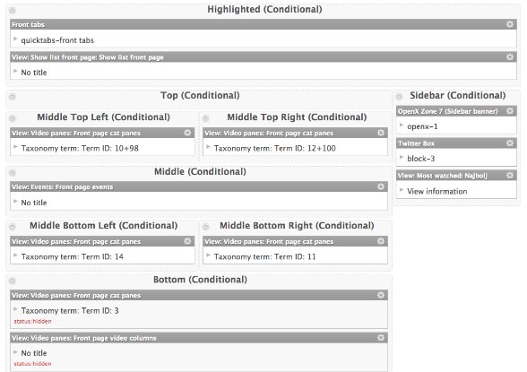
10. Using page templates for each sub page
Try to omit page--xxx-tpl.php templates. It duplicates the code, and makes maintenance difficult.
Try using Context Layout or Panels if variations are really needed.
Panels have dragable user interface system and a layout generator tool. No code needed!

Slide 17
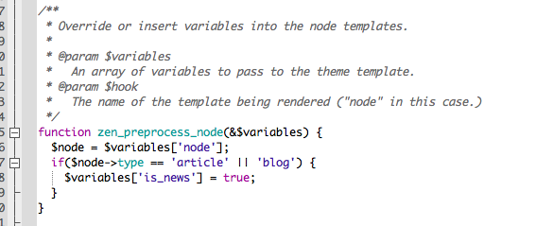
11. Logic in templates
SQL queries and calculations don't belong to the template layer. If logic is not so advance it can be placed in the preprocess function in template.php file.
About process & preprocess: http://drupal.org/node/223430

Slide 18
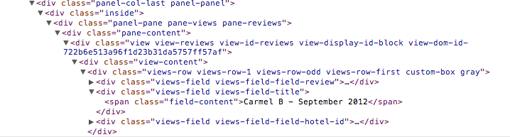
12. Using too common CSS TARGETING
Drupal outputs a LOT of markup with specific HTML classes and ids. Knowing which class is appropriate to target is the key.
Ids are usually unique identifiers for blocks/nodes/views
views have classes with view name and display name seperated. Don’t target displays (e.g. .views-display-id-block)
.items-list, .content, .view-content etc. are used all over your Drupal site, don’t use for specific targeting.

Slide 19
13. NoT using the basic Drupal functions
Drupal comes with some very handy functions, we should use them
- l() and url() - in contrast of hardcoded relative URL address can outputs aliased URL path
- base_path(), returns base URL of the Drupal installation
- theme() functions like theme('image_style',array()) to out put styled image

Slide 20
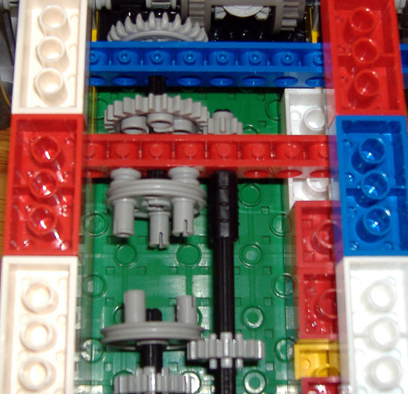
Coding
Developing custom modules

Slide 21
14. coding
There is a 80% possibility that what you want to build can be build with a combination of modules.
Usual suspects:
Views (your UI for SQL queries)
views_field_view, views_bulk_operations
Rules (executing commands on events)
Panels (overriding default paths like node/%nid)
Filed collection (join fields into one field)

Slide 22
15. Hacking core and contrib modules
Fixing code directly in the module files makes the website impossible to update. Instead Drupal provides hooks and preprocess functions.
More about hooks: http://api.drupal.org/api/drupal/includes!module.inc/group/hooks/7

Slide 23
16. Not using API functions
Database API, dynamic queries: http://drupal.org/node/310075
Entity query API: http://drupal.org/node/1343708
Bets to learn from examples:
http://drupal.org/project/examples

Slide 24
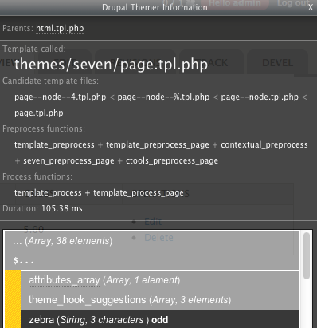
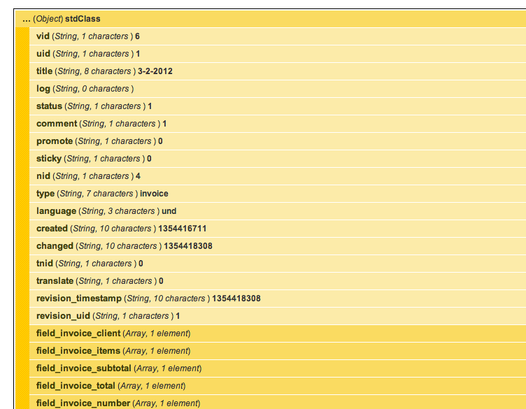
17. Not knowing how to debug
When you would usually use print_r() to get the content of a array or object to your browser, Drupal has Devel (http://drupal.org/project/devel):
dpm($variable) – prints content of variable in human friendly way
You can also store info to a log: http://drupal.org/project/object_log
Can’t find the right template? Use Devel Themer (http://drupal.org/project/devel_themer)

Slide 25
18. NOT RESPECTING THE Coding standards
Different approaches and coding styles make code less organized and makes the job for other developers mode difficult.
two spaces indentation
$var = foo($bar, $baz, $quux);
$some_array = array('hello', 'world', 'foo' => 'bar');
<?php print $title; ?>

Slide 26

Finishing & maintaning
When you think its over…

Slide 27
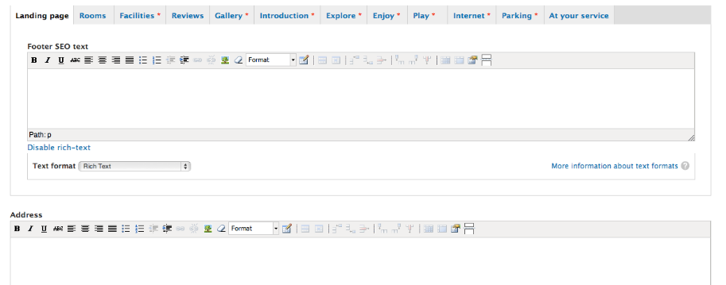
19. Forgetting about Back-end uX
Drupal is criticized for having a bad user experience for end users.
I argue that with the argument that since Drupal is a framework, back end should be part of out efforts when building a website.

Slide 28
20. Forgetting about you Drupal website
Drupal needs love even after you have finished your website. Keeping core and modules updates makes it easier to upgrade at some time and keeps the system safe.

Slide 29
How to avoid failing on your first project?
Read books
Get a mentor
Fail & learn from it

